Slide 1


NYKKA
ADD Colors
PRESENTED BY:
MOUSIN TAJ
KUMARI NEHA
PRAKRUTHI C
SAHZIYA SAREEF
VAISHNAVI R B

Slide 2

OBJECTIVE
Implementing the skills learnt to work with front end and back end technologies
Confident in all the concepts
And to work on the same

Slide 3

Problem statement
To develop an Ecommerce web application to perform online shopping

Slide 4
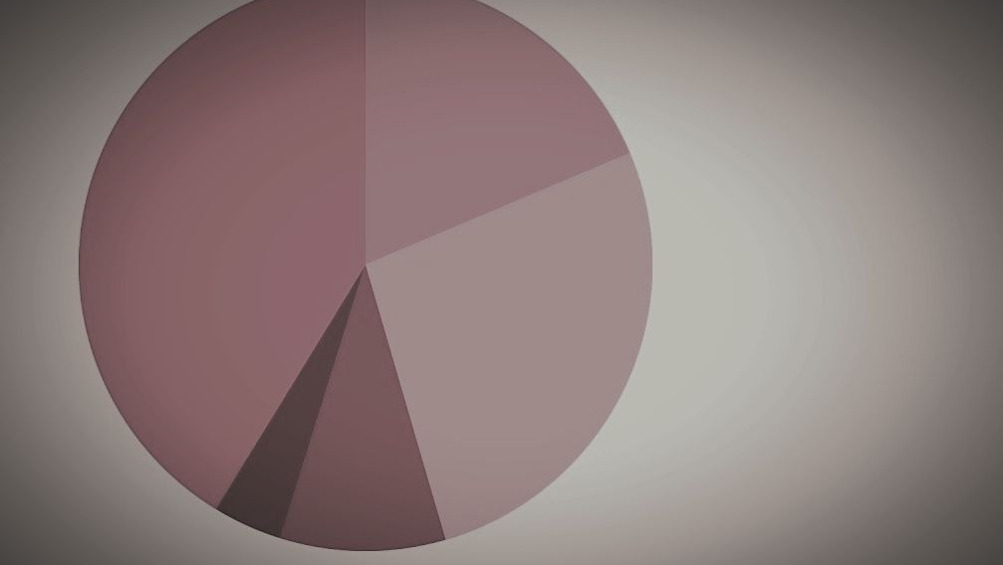
Tools used
Angular 7, Spring Boot
HTML, CSS, Bootstrap
Maven, Tomcat
Jenkins, MyBatis
Core Java, Database(MySQL)

Slide 5
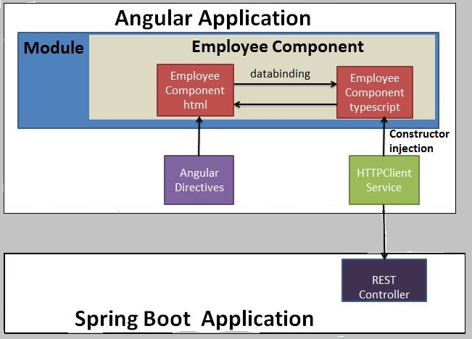
PROJECT ARCHITECTURE

Slide 6
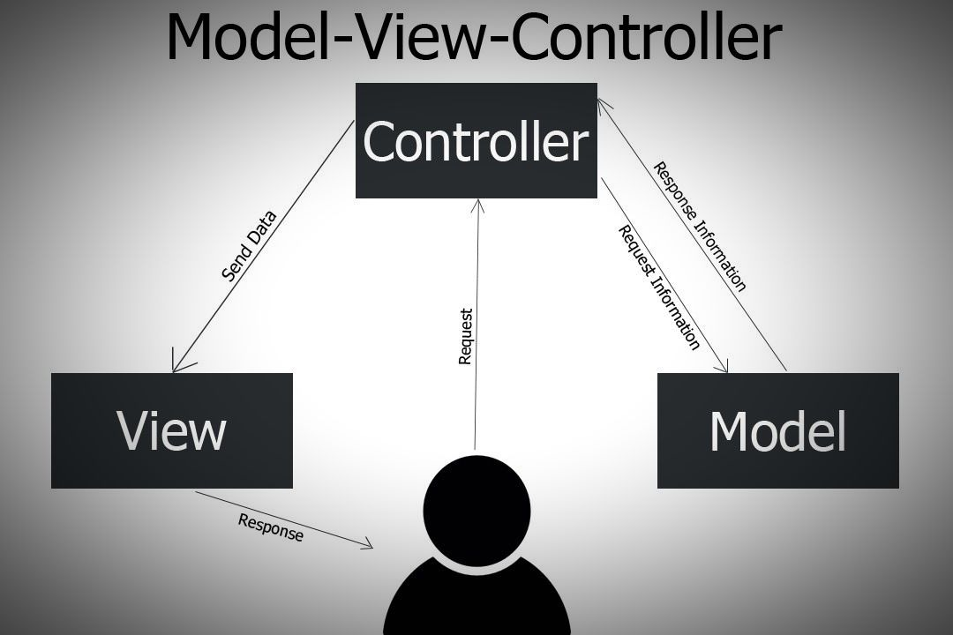
Mvc architecture

Slide 7
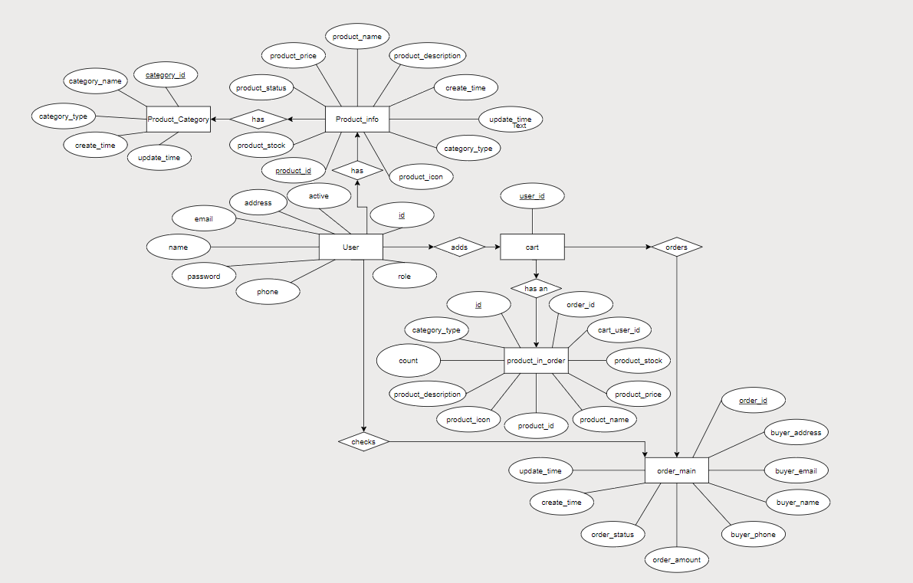
ER DIAGRAM

Slide 8
functionality
Browse through products
Add items to the cart
Delete Items
Update Stock
Sign-out
User Sign-up/ Sign-in
Check-out/Payment/ Sign-out
Admin Sign-in

Slide 9
Workflow
Home page
Sign-up, Sign-in
Product page
Cart page
Payment
User?

Slide 10
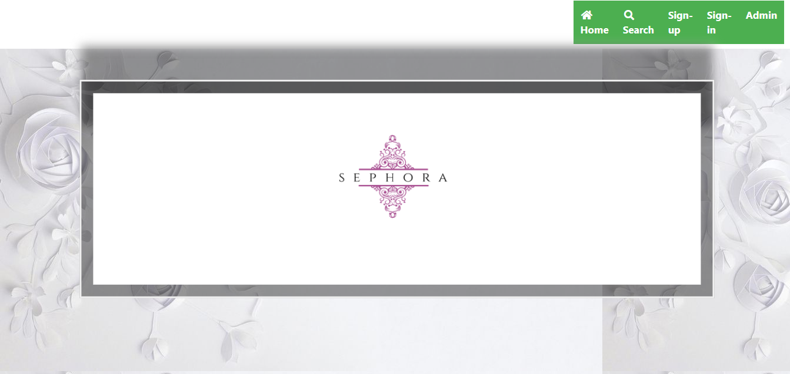
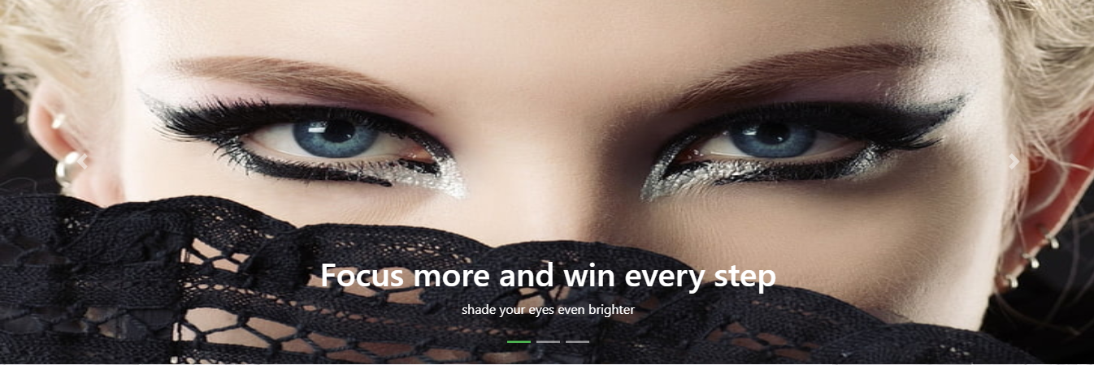



Slide 11
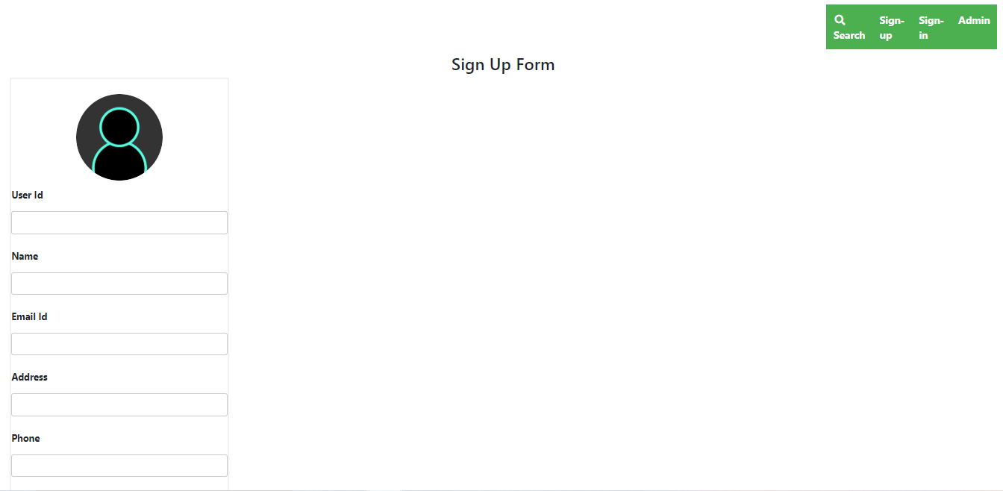
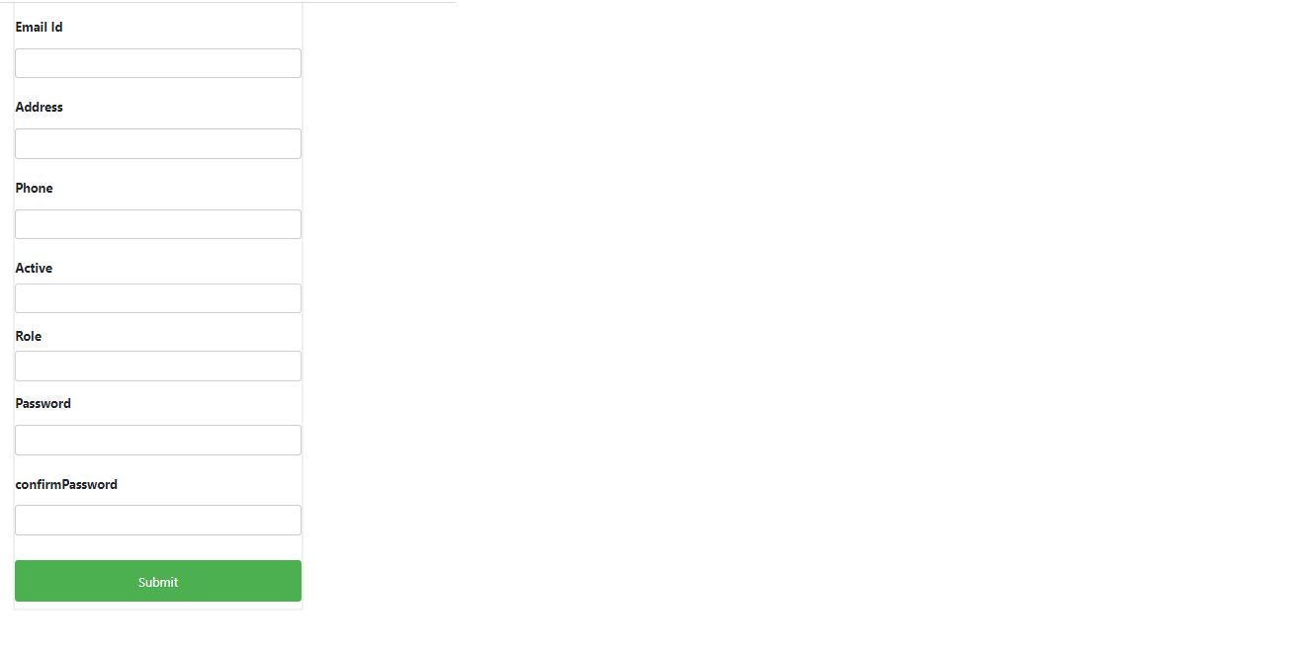
New user?

Slide 12
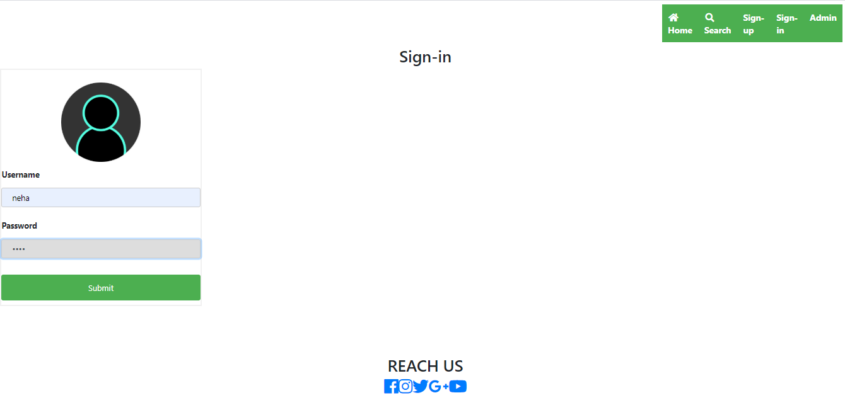
Already a user?

Slide 13
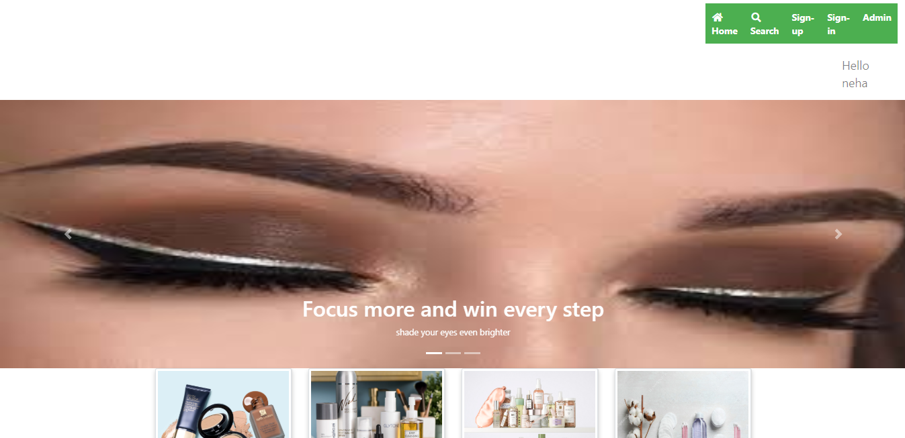
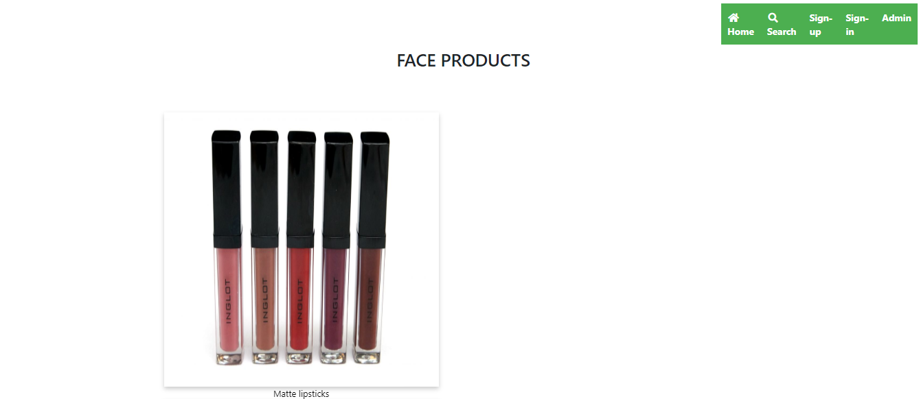
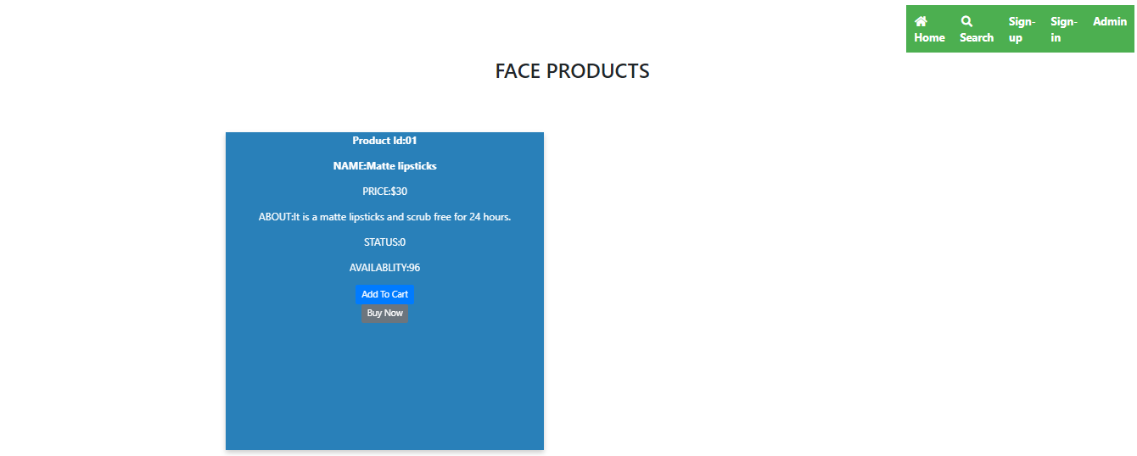

Slide 14
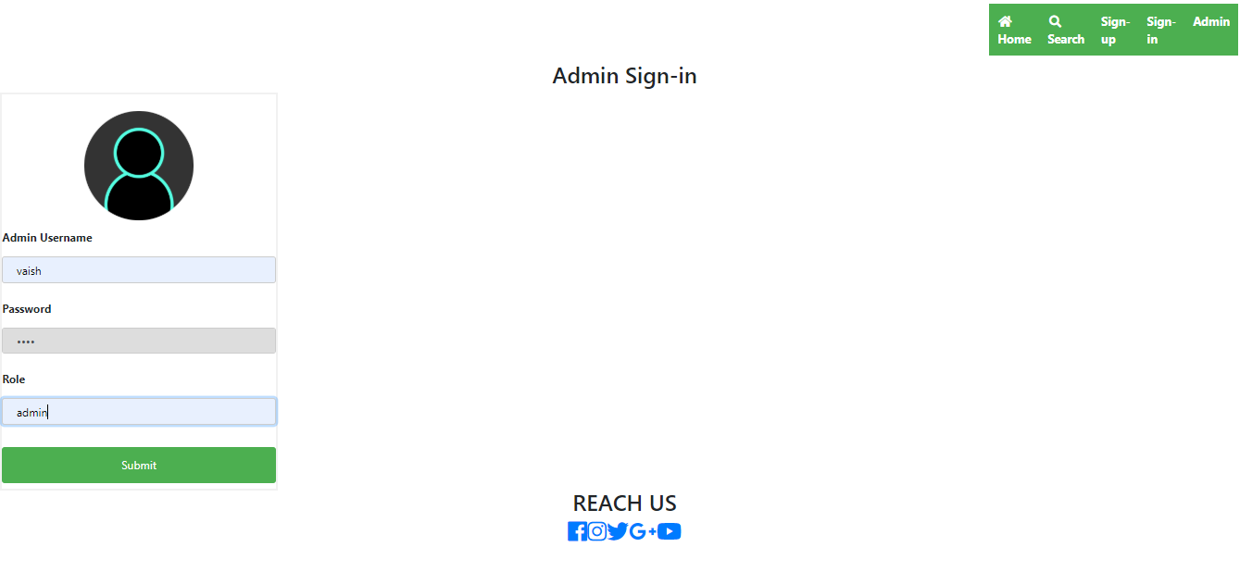
ADMIN??

Slide 15
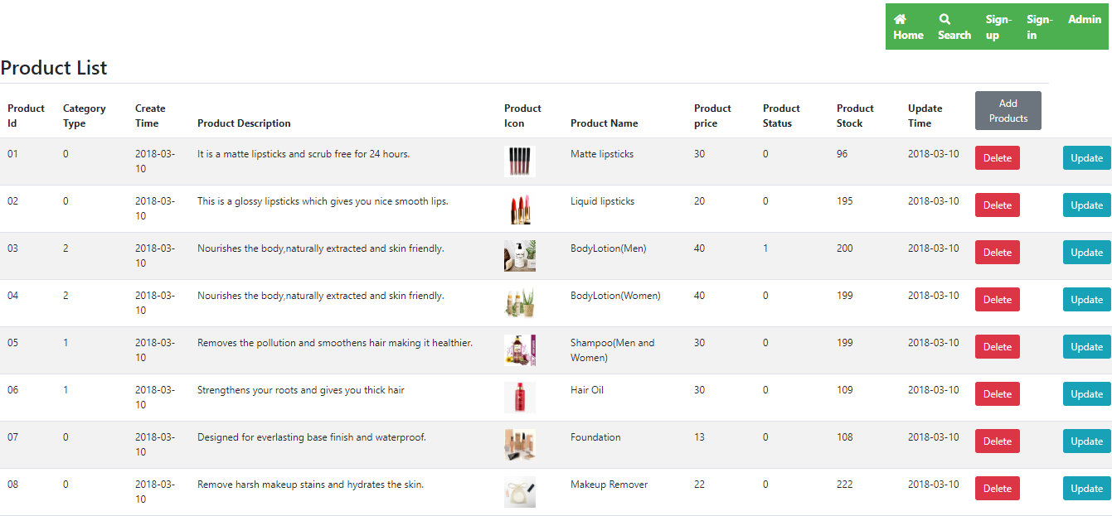

Slide 16
conclusion
This project helped us in gaining valuable information and practical knowledge on several topics like designing web pages using html & css, usage of responsive templates, designing of android applications, and management of database using mysql .
Also the project helped us understanding about the development phases of a project and software development life cycle.

Slide 17
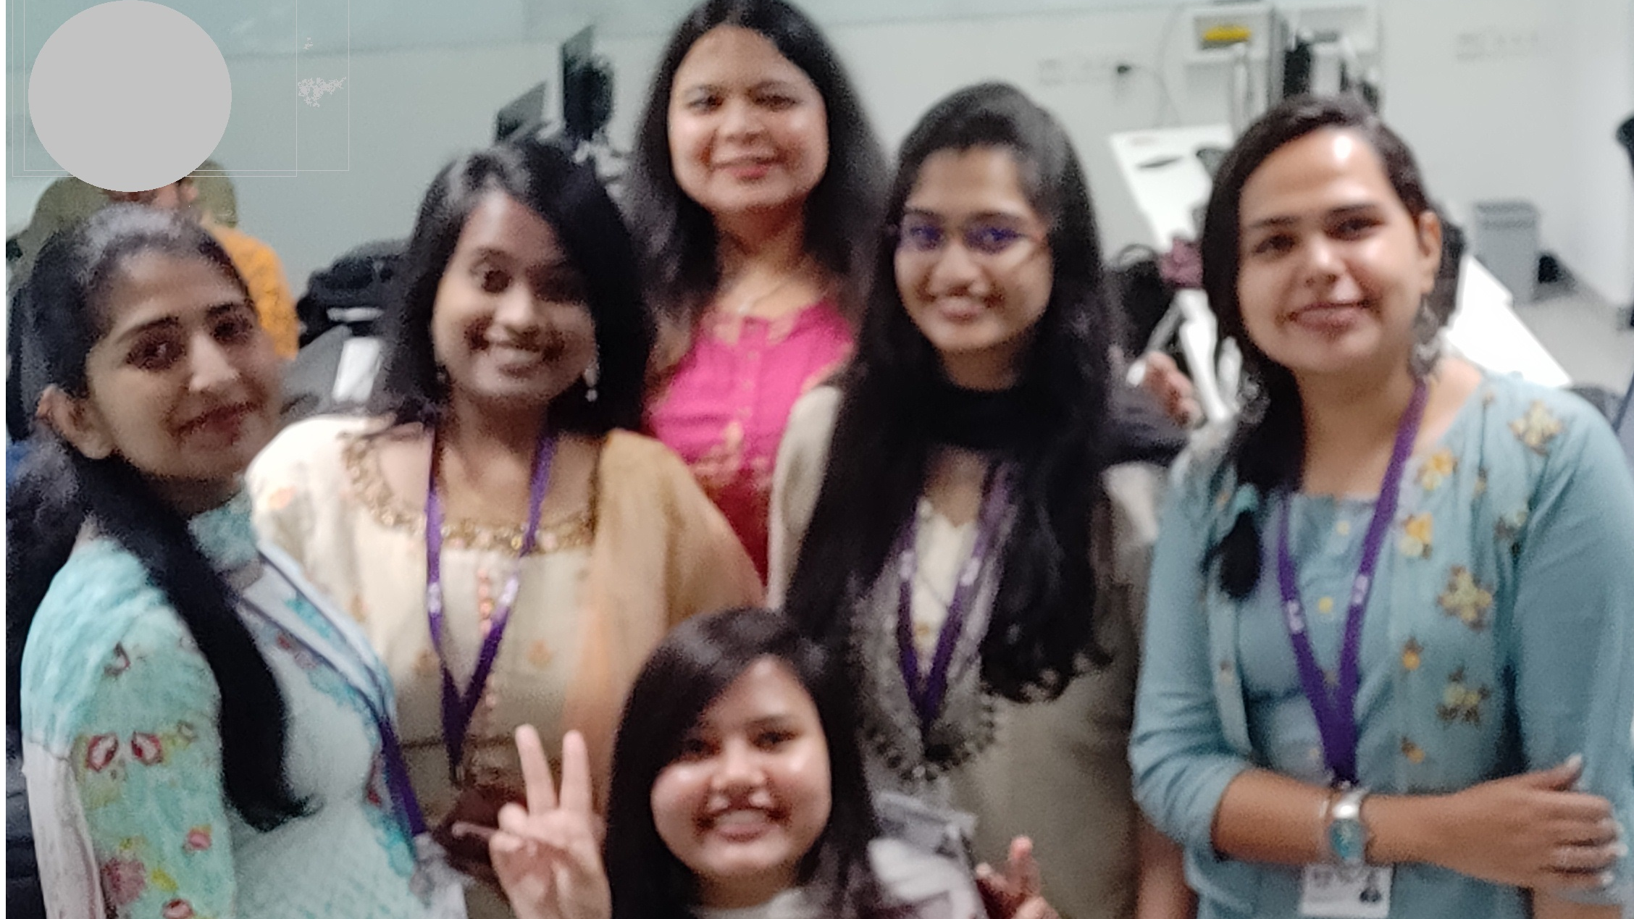
The team

Slide 18

Thank you!

